Slide 1
College of Western Idaho SWDV 210 Introduction to Server Side Programming
Lab - Arrays

Slide 2
Lab - Arrays
One of your team members, Sirius, started working on Exercise 11-1 (page 347) but disappeared on extended leave before finishing. Your job is to finish the incomplete tasks including testing.
Test & debug the solution found in BB. Add, delete, modify, promote & sort.
Here are some user testing comments so far:
Please remove warning error.
Unable to add a task.
Unable to delete a task.
Modify task does not work.
Sort is backwards.
When I enter a task in lower case the sort does not work alphabetically.
Promote is flaky when promoting #1 task instead of error.
Please remove the default tasks.
Please remove the task list that appears above ‘Tasks:’.
See starter in BB.
Extract the files and place the folder in c:/xampp/htdocs/ex_starts
Expected output on next slide.
Notes:
See starter in \\swdvdc3\c$\Shares\StudentFiles\3rdSemester\SWDV210\Examples
Download starter file to c:/xampp/htdocs/ex_starts/

Slide 3
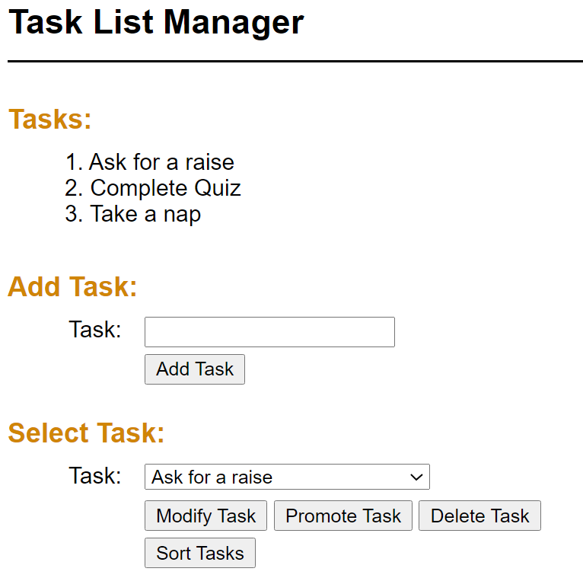
Expected Output

